Slide 1
Efficiency Analysis
Of our three cinemas

Slide 2
Project Goal
Understand the relationship between the movie rental costs and the generated revenue.
To do that we need:
A table that shows the monthly performance for each movie across all locations.

Slide 3
Our Data
Movie Catalogue
Invoices
nj_001
nj_002
nj_003
detailed information about movies released in 2024
represents the invoices issued for showing a specific movie at various theater locations during different month
information on all transactions from location 1
information on all transactions from location 2
information on all transactions from location 3

Slide 4
The Concept
The DAG

Slide 5
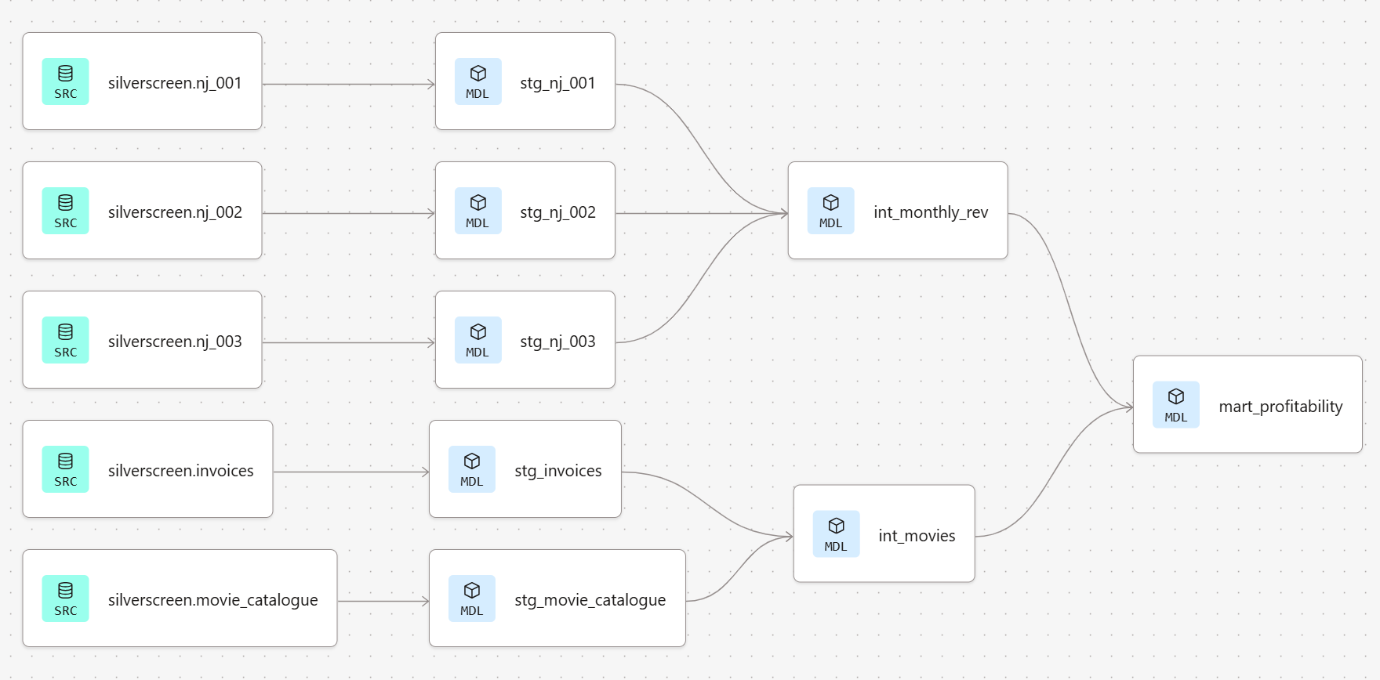
The final model

Slide 6
Steps to achieve the goal
Connection & Preparation
Sources & Staging models
01
02
Intermediate & marts models
Schema, Tests & Jobs
03
04
Created Database Connection, dbt setup
Implement sources in yml file, created staging models
created intermediate & marts models
Created Documentation, implement tests & Job for automation

Slide 7
Dbt & Snowflake Showcase
Sources & Schema
Models
Tests
dbt build
Job

Slide 8
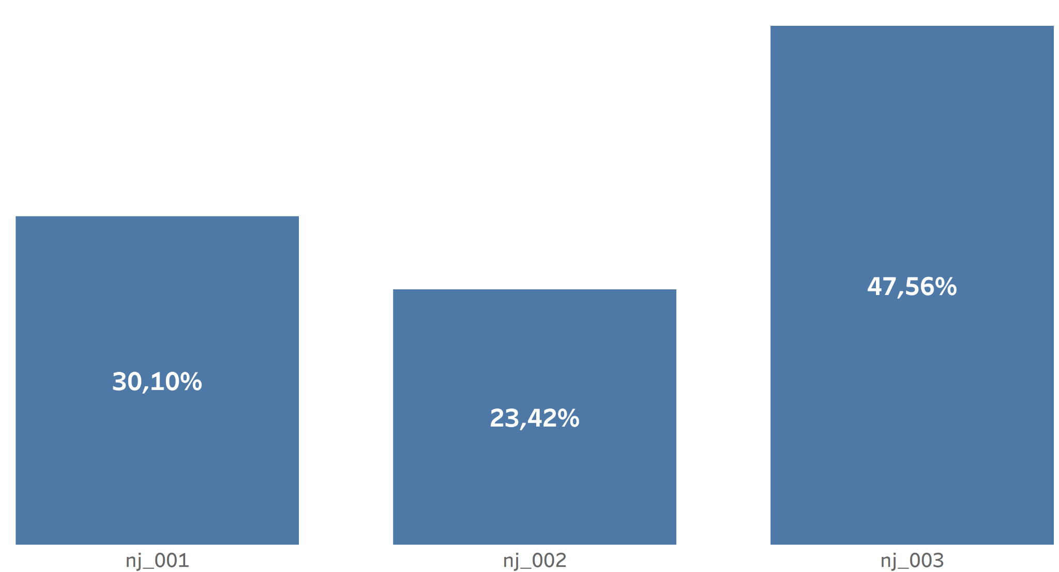
Efficiency Analysis
None of the cinemas are profitable.
Cinema 3 performs the best.

Slide 9
Recommendation
Reduce rental cost
Attract more visitor with marketing campaign
further analysis in BI tool

